Slide 1
Advances in Business Automation
28 February 2021
GU Zhan 顾 瞻 (Sam) zhan.gu@nus.edu.sg
OVER
OFFERING OVER
TRAINING OVER
6,620
GRADUATE
ALUMNI
150
ENTERPRISE IT, INNOVATION
& LEADERSHIP PROGRAMMES
148,000
DIGITAL LEADERS
& PROFESSIONALS

Slide 2
Agenda
1.1 Overview
1.2 Hard Automation vs. Soft Automation
1.3 New Jobs in Automation Era
1.4 Summary

Slide 3
Agenda
1.1 Overview
1.2 Hard Automation vs. Soft Automation
1.3 New Jobs in Automation Era
1.4 Summary

Slide 4

Automation at Home
Source https://i.warosu.org/data/biz/img/0012/12/1461543092681.jpg

Slide 5
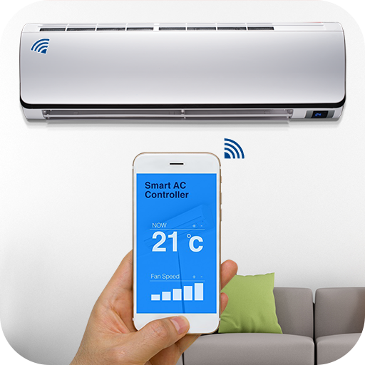
Air-Con?

Slide 6

Robotic Vacuum?

Slide 7

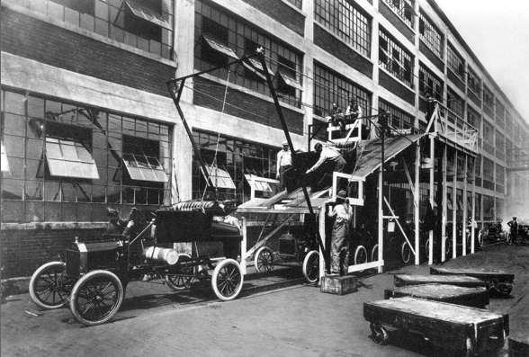

1.1 Overview : Automaton History
The evolution of task automation
Mayans automating water transportation via aqueducts
Henry Ford’s automation of the mechanical assembly line
Now: New age of intelligent automation.
Source
https://direct.astutesolutions.com/wp-content/uploads/2020/11/mayan-aqueducts-e1605620293474.jpg
https://upload.wikimedia.org/wikipedia/commons/d/d6/A-line1913.jpg

Slide 8
1.1 Overview : Business Automaton
What's Automation?
Automation is the technology by which a process or procedure is performed with minimal human assistance.
Purpose of Automation?
Make use of automated machinery [cost1] to produce the most the need at scale [value] with the least human effort/intervention [cost2]. E.g. Conduct 10x more GovTech sessions with 10x less ISS lecturers, by using automated machinery/technology.
What's Business?
A business is an organization where people work together. In a business, people work to make and sell products or services [value].
Purpose of Business Automation?
In a business, people work (less) [cost2] to make and sell (more) products or services [value], by using automated machinery/technology [cost1], e.g. RPA, AI, Robotics.
WHEN [value] > [cost1] + [cost2] THEN Automate

Slide 9
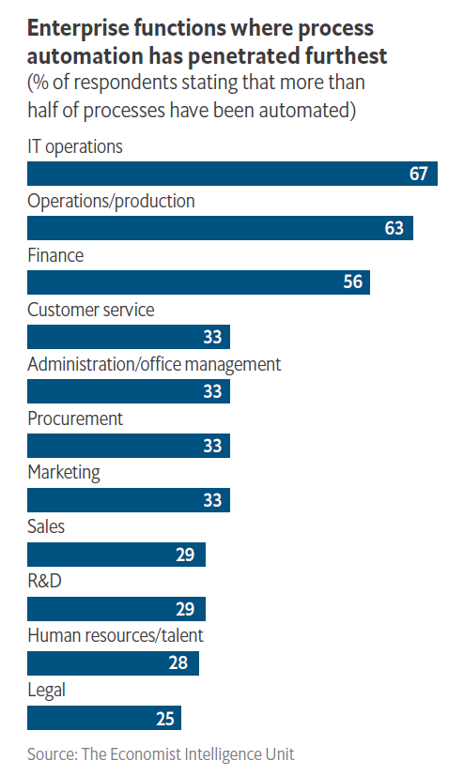
The Economist - The advance of automation - Business hopes, fears and realities
A survey of 502 C-suite executives
https://automationfirst.economist.com/wp-content/uploads/2019/06/EIU-UiPath-The-advance-of-automation-briefing-paper.pdf

Slide 10
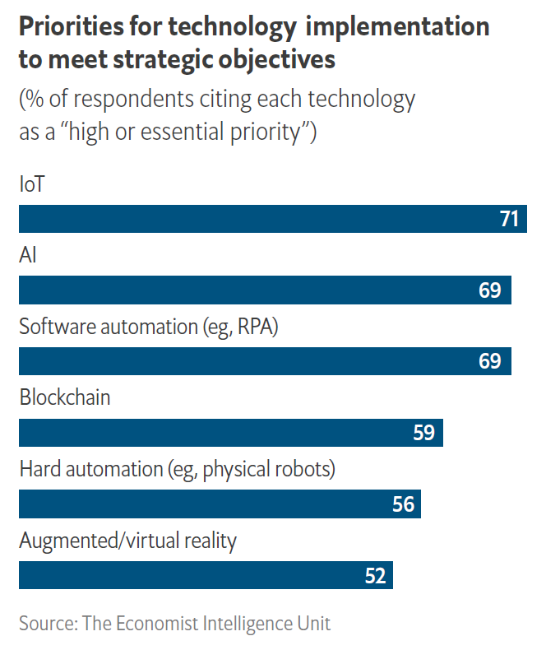
The Economist - The advance of automation - Business hopes, fears and realities
A survey of 502 C-suite executives
https://automationfirst.economist.com/wp-content/uploads/2019/06/EIU-UiPath-The-advance-of-automation-briefing-paper.pdf

Slide 11
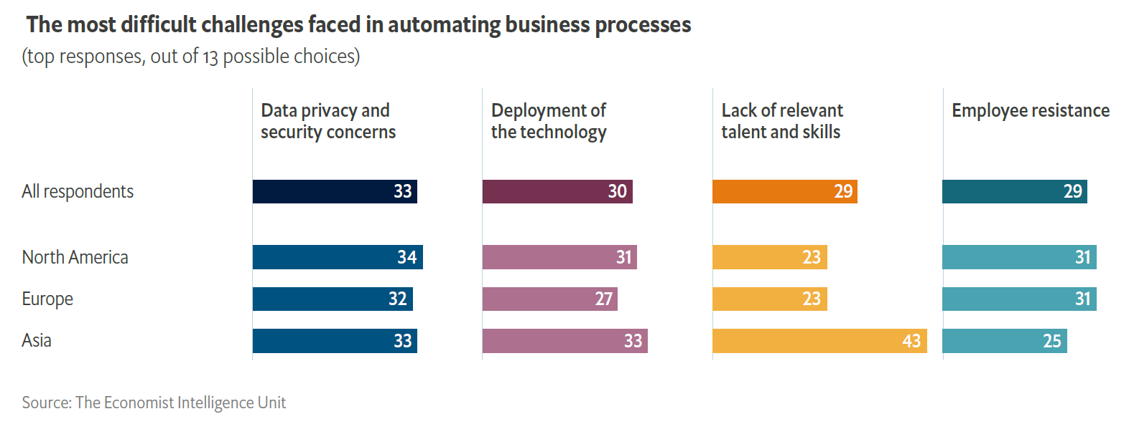
The Economist - The advance of automation - Business hopes, fears and realities
A survey of 502 C-suite executives
https://automationfirst.economist.com/wp-content/uploads/2019/06/EIU-UiPath-The-advance-of-automation-briefing-paper.pdf

Slide 12
Agenda
1.1 Overview
1.2 Hard Automation vs. Soft Automation
1.3 New Jobs in Automation Era
1.4 Summary

Slide 13
1.2 Hard Automation vs. Soft Automation
Hard Automation using physical robots in physical environment, e.g. Factories, Singapore parks
Manipulator Robotics
Mobile Robotics
Soft Automation using software agents in virtual environment, e.g. Email inbox, Internet Web
Rule-based Automation (RPA Software Agent)
AI-based Automation (Intelligent Process Automation IPA = RPA + AI Software Agent)

Slide 14
1.2.1 Hard Automation (Robotics)

Slide 15
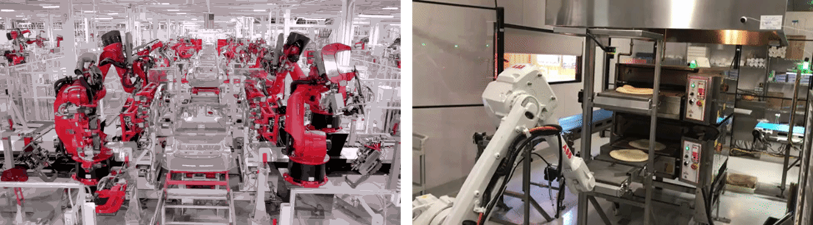
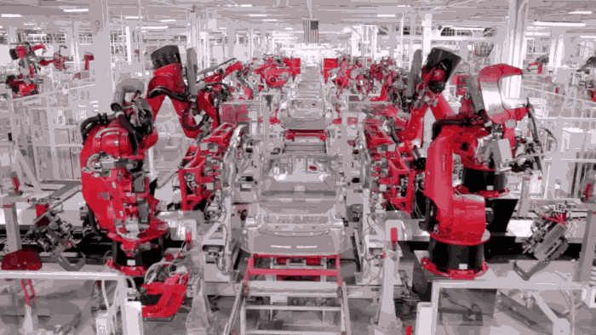
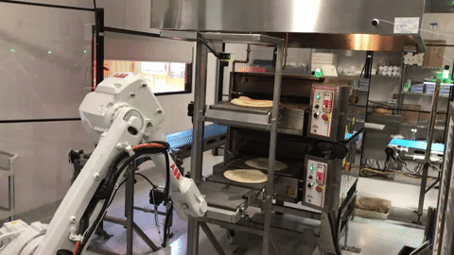
1.2.1 Hard Automation : Manipulator Robotics
Automate 'Hard' Processes

Slide 16


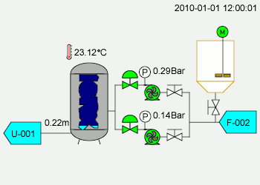
1.2.1 Hard Automation : Manipulator Robotics
Automate 'Hard' Processes
NEWater: A Singapore Success Story
https://youtu.be/DWWU-8_4wu0

Slide 17
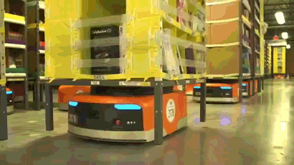
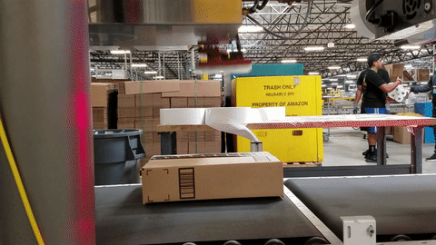
1.2.1 Hard Automation : Mobile Robotics
Automate 'Hard' Processes

Slide 18
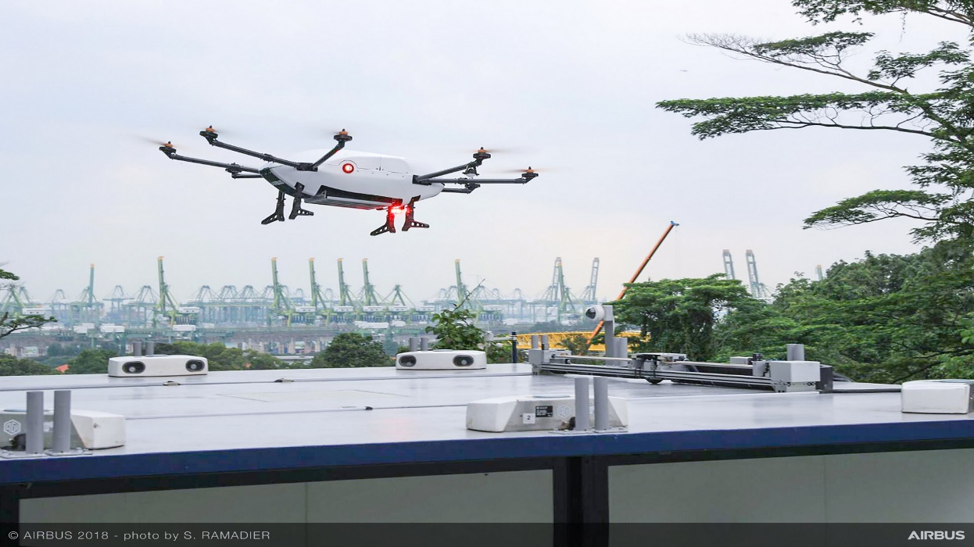
1.2.1 Hard Automation : Mobile Robotics
Automate 'Hard' Processes
Airbus Skyways drone
SPOT
https://youtu.be/viuR7N6E2LA
Source: https://airbus-h.assetsadobe2.com/is/image/content/dam/events/airshows/Airbus-skyways-project-day3-SIN2018-002.jpg
Source: https://www.arabnews.com/node/1671696/offbeat

Slide 19
1.2.2 Soft Automation (Software Agents)

Slide 20
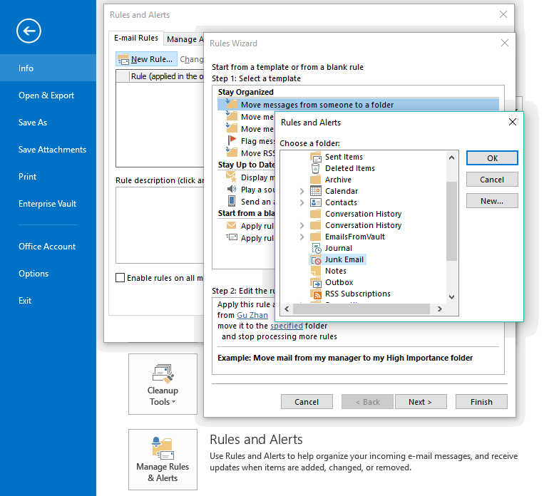
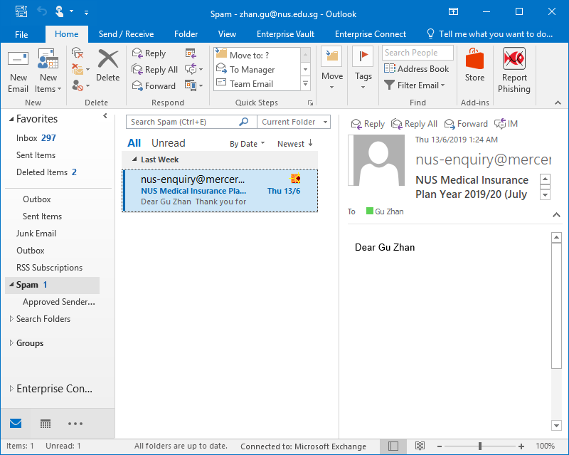
1.2.2 Soft Automation : Rule-based BPA RPA
Automate 'Soft' Processes

Slide 21
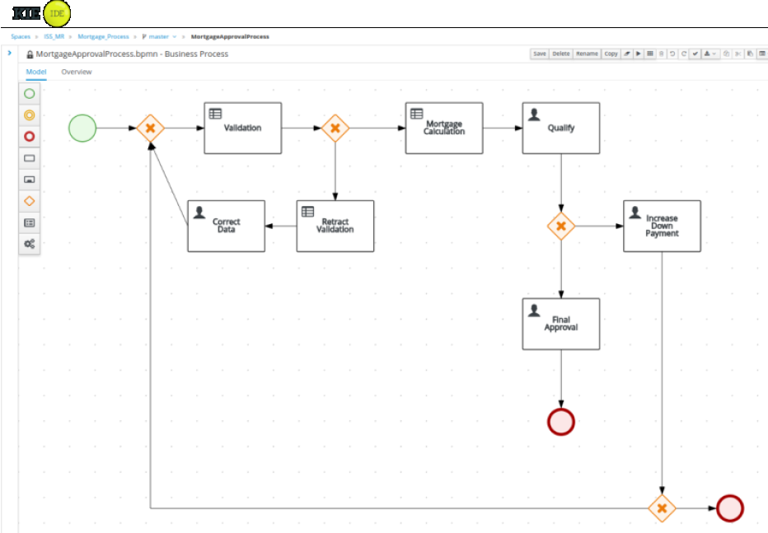
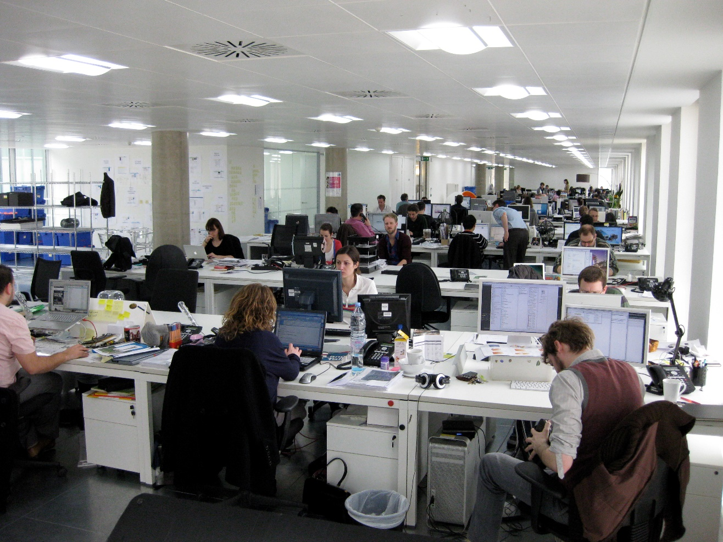
1.2.2 Soft Automation : Rule-based BPA RPA
Automate 'Soft' Processes

Slide 22
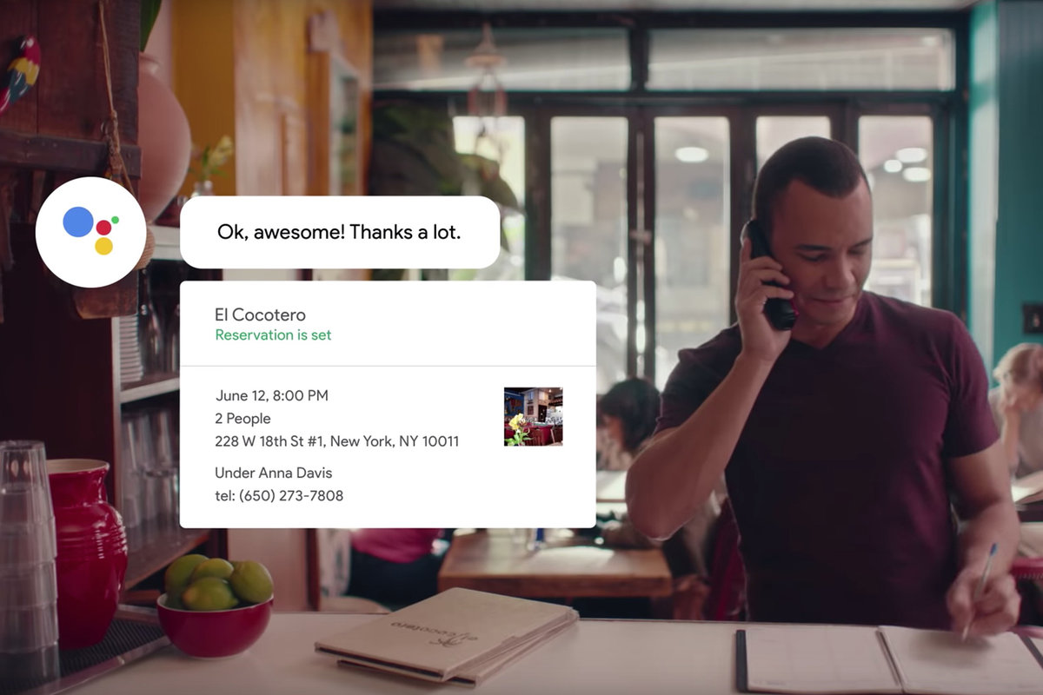
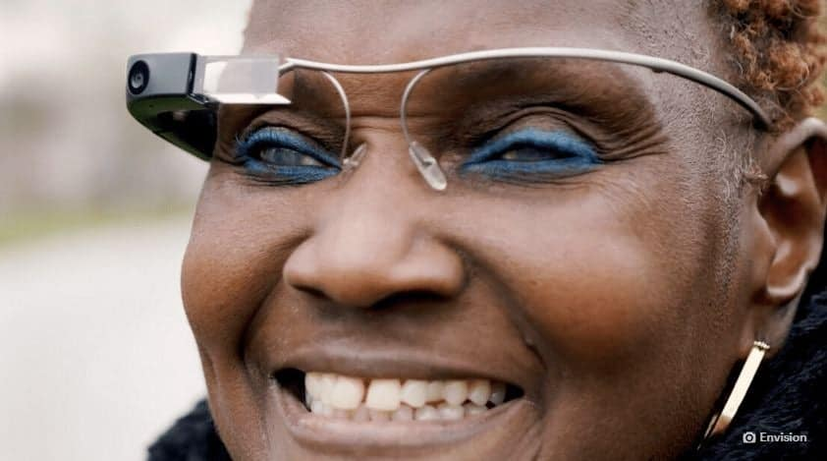
1.2.2 Soft Automation : AI-based IPA
Automate 'Soft' Processes
Google Duplex
https://youtu.be/-qCanuYrR0g
EnVision Glass S$5,265
https://www.letsenvision.com/envision-glasses
Source: https://cdn.pocket-lint.com/r/s/1200x/assets/images/146008-feature-google-duplex-release-date-how-to-try-the-human-sounding-ai-bot-image1-gyt9zdpgu4.jpg
Source: https://www.gizchina.com/2020/03/11/envision-glass-developed-with-google-will-help-the-blind-to-see/

Slide 23
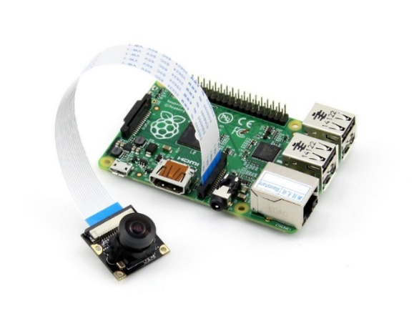



1.2.2 Soft Automation : AI-based IPA
Automate 'Soft' Processes
NUS-ISS Open Vision Glass S$200
EnVision Glass S$5,265
https://www.letsenvision.com/envision-glasses
Source: https://www.gizchina.com/2020/03/11/envision-glass-developed-with-google-will-help-the-blind-to-see/

Slide 24

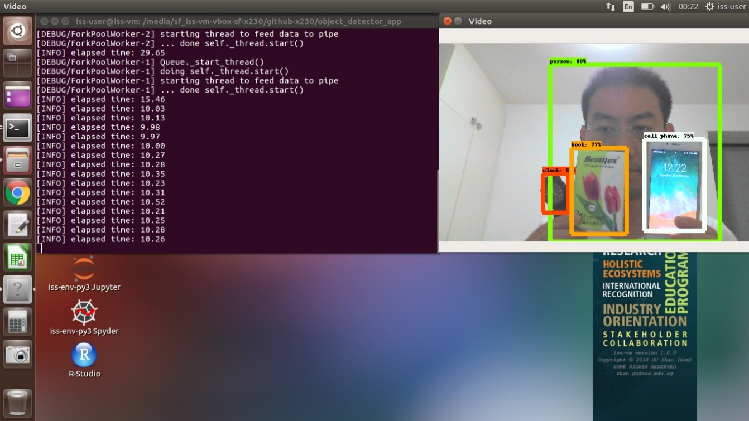

1.2.2 Soft Automation : AI-based IPA
Object Detection
Source https://github.com/telescopeuser/object_detector_app
Source https://github.com/bourdakos1/Custom-Object-Detection

Slide 25
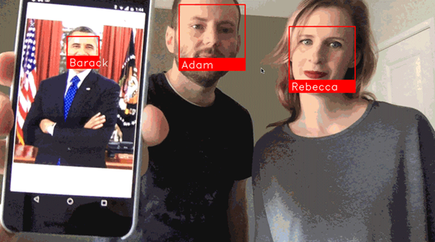
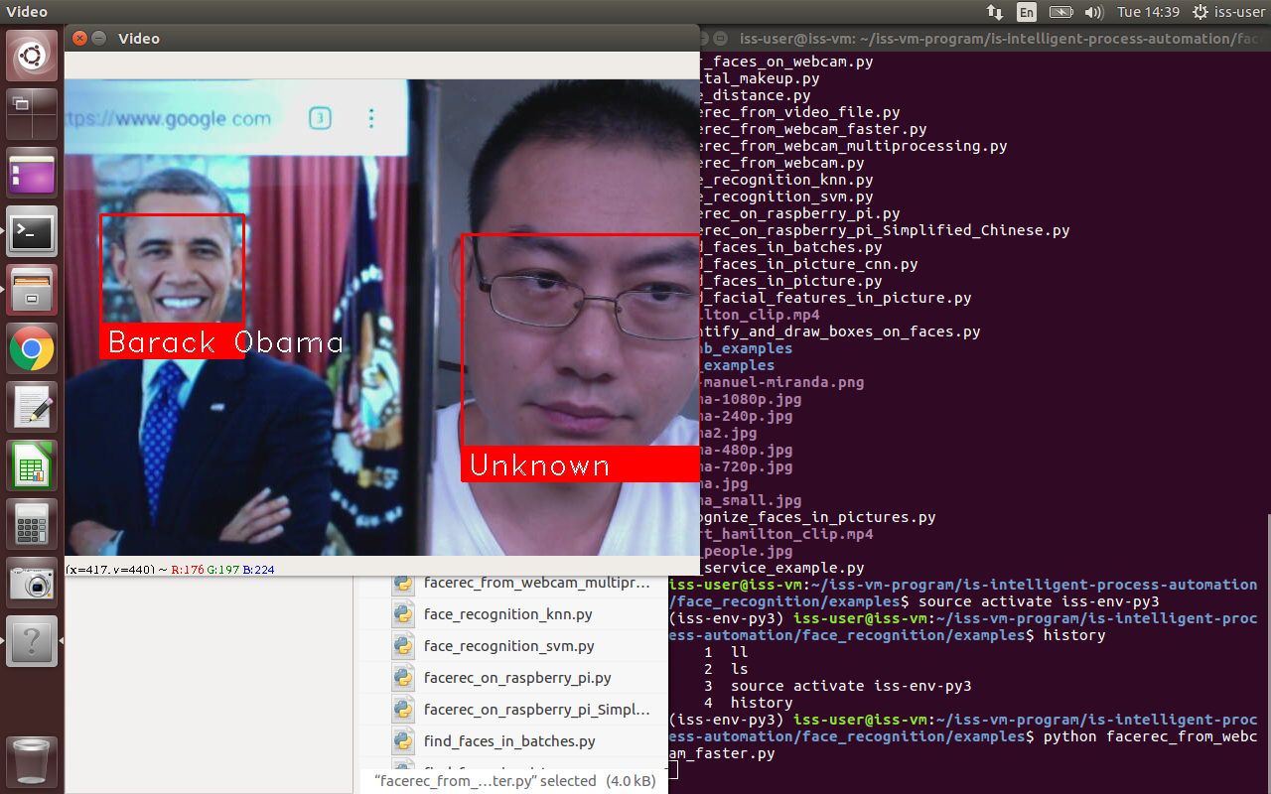
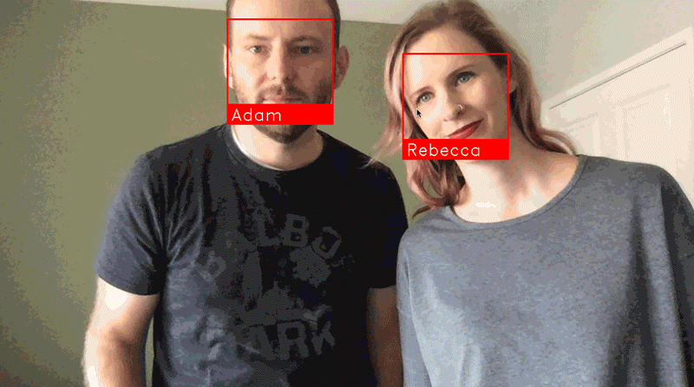
1.2.2 Soft Automation : AI-based IPA
Face Detection
Source https://github.com/ageitgey/face_recognition
Source https://github.com/telescopeuser/S-IPA-Workshop/tree/master/workshop1/LocalAI/IPA_a_facedetect

Slide 26
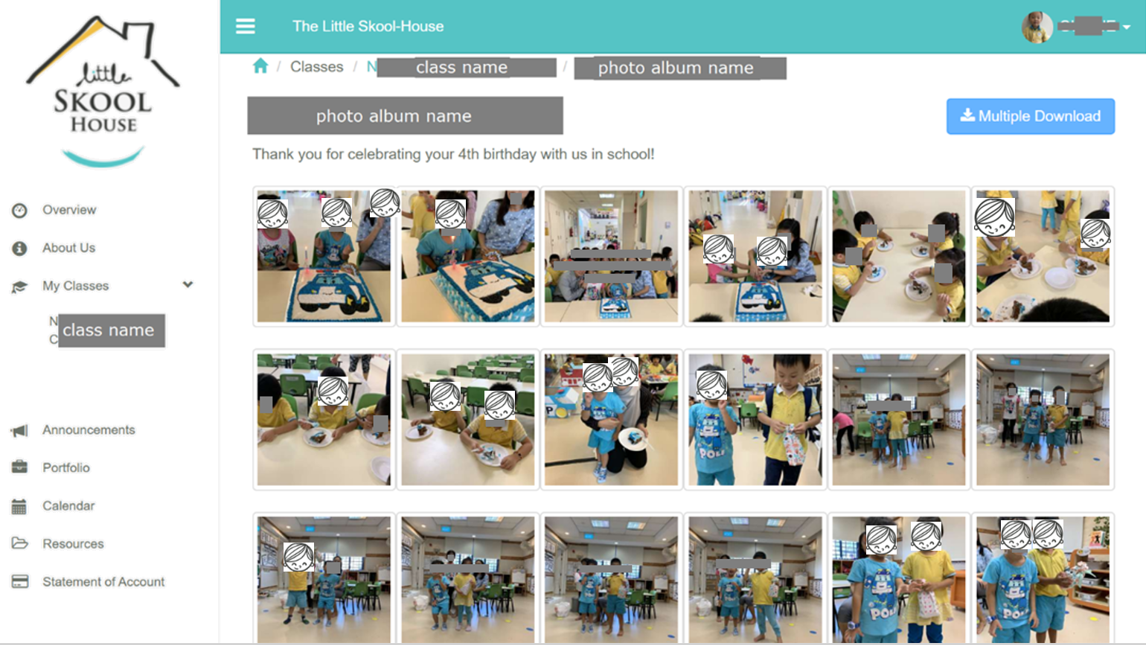

Slide 27

Parcel Tracker
Source https://europost.eu/web/files/articles/22274/gallery/thumb_910x0_660410-4.jpg

Slide 28
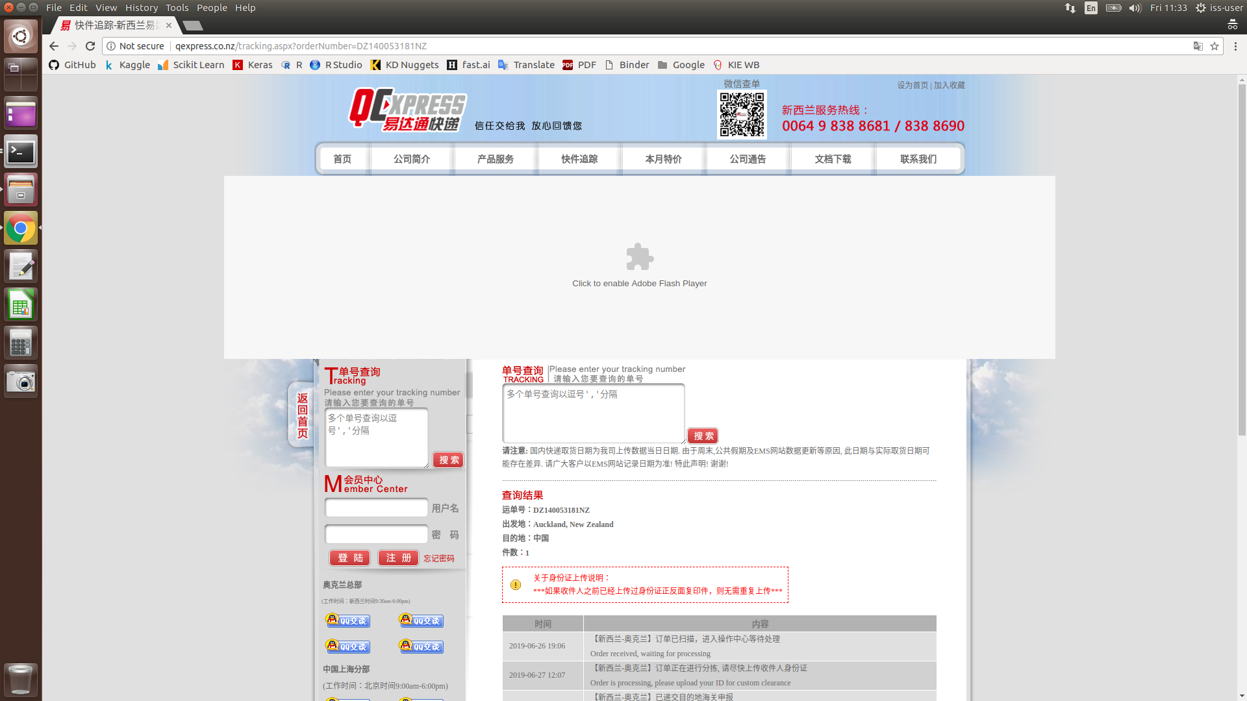

Slide 29
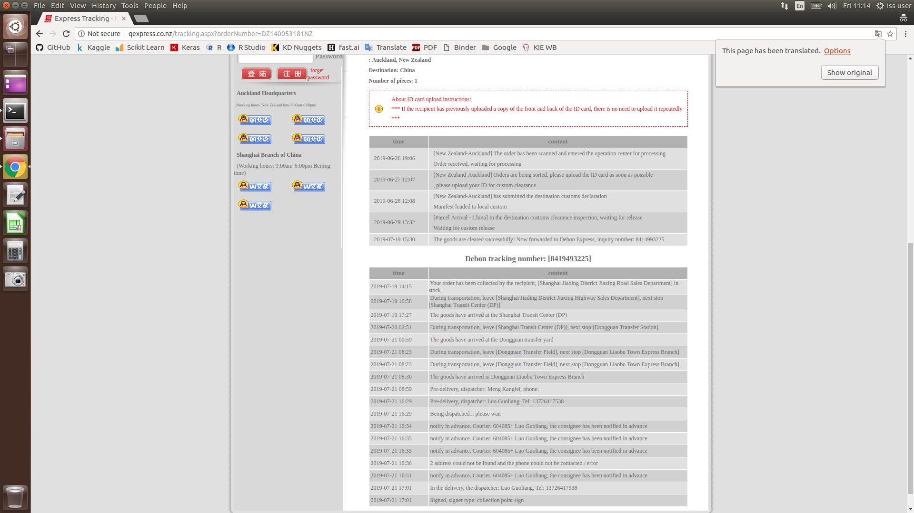

Slide 30
Agenda
1.1 Overview
1.2 Hard Automation vs. Soft Automation
1.3 New Jobs in Automation Era
1.4 Summary

Slide 31
1.3 New Jobs in Automation Era
Automation administrator: Automation software runs using logical rules, not magic. It does exactly as it is told. And that means that someone needs to tell it what to do.
Automation economist (Statistician, Scientist): The prediction that automation is set to destroy future jobs might be off the mark. But, without automation, we wouldn’t have the experts to measure performance and reassure us of that.
AI trainer: You need to 'teach' our automation tools to translate input into the desired outcome. It’s not unlike the way a dog needs training if you want it to do something.
Business Process Automation (BPA) programmer: AI might be learning how to write code. Automation software might seem extremely able and smart. But as clever and as capable as your automation tool may be, it’s not smart enough to code itself into existence.
Source: https://www.thinkautomation.com/future-of-work/ten-future-jobs-already-here-thanks-to-automation/

Slide 32
1.3 New Jobs in Automation Era
Chatbot copywriter (design dialogs/conversations): As much as chatbots are coming into their own in customer service interactions, they aren’t helpful, friendly, or witty by themselves. Nor are they tone sensitive.
ML/AI engineer: Machine learning is a subsection of artificial intelligence. It’s a core tool that’s helping fuel more and more automated decisions.
Robot technician: The maintenance of the physical automation machines is already a common job in manufacturing. Nowadays, robots are spreading into retail and even the home. As these uses of robots become increasingly commonplace, the role of robot technician is set to rise alongside it.
Machine relations manager (psychologist HR): Humans are increasingly working alongside automation and robots. It might be an obvious side effect of the rise of automation, but that doesn’t mean that it’s a partnership that comes easily.
Source: https://www.thinkautomation.com/future-of-work/ten-future-jobs-already-here-thanks-to-automation/

Slide 33
Agenda
1.1 Overview
1.2 Hard Automation vs. Soft Automation
1.3 New Jobs in Automation Era
1.4 Summary

Slide 34
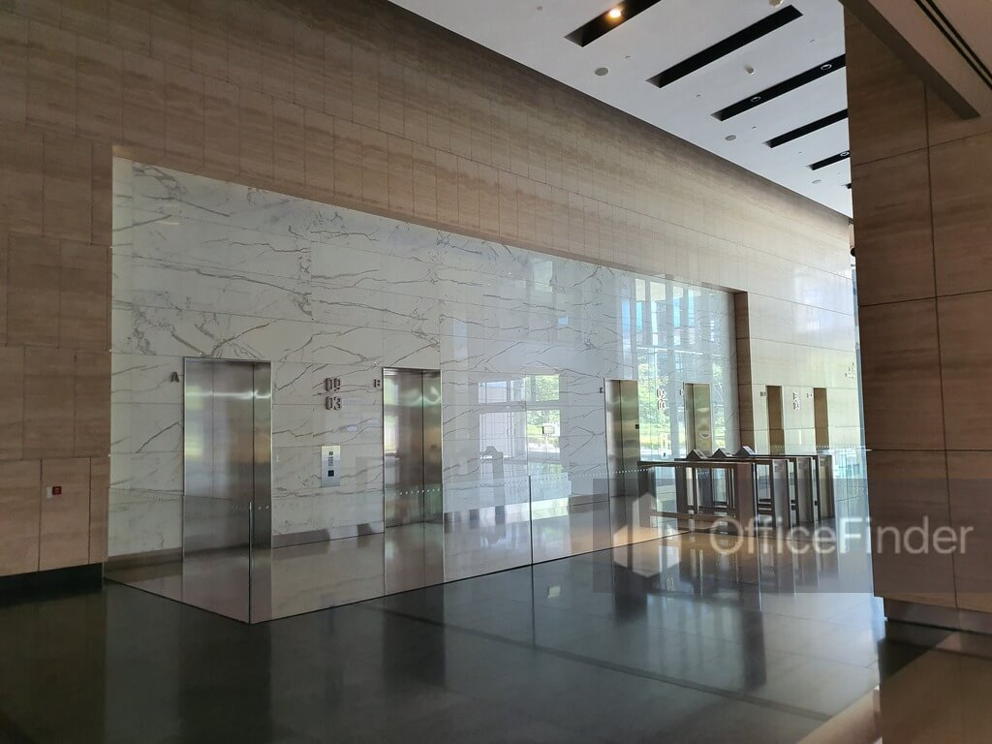
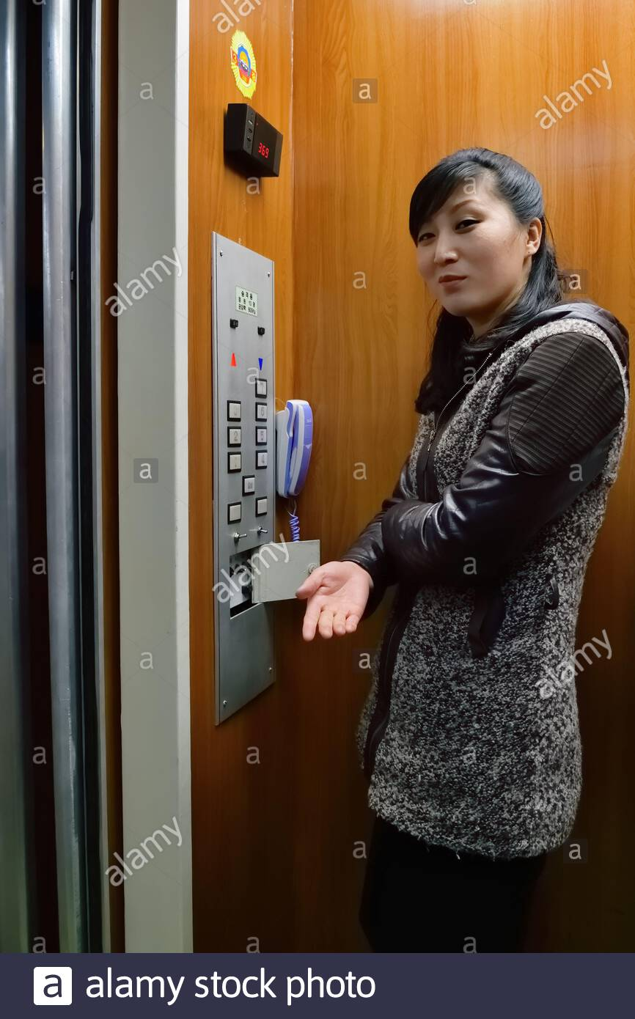
1.4 Summary
vs.
Source: https://officefinder.com.sg/wp-content/uploads/2020/02/Marina-Bay-Financial-Centre-Lift-Lobby.jpg
Source: https://c8.alamy.com/comp/2C2H896/pyongyang-north-korea-april-29-2019-elevator-operator-girl-invites-to-lift-up-almost-any-mechanism-in-the-country-has-an-operator-as-a-way-to-2C2H896.jpg

Slide 35
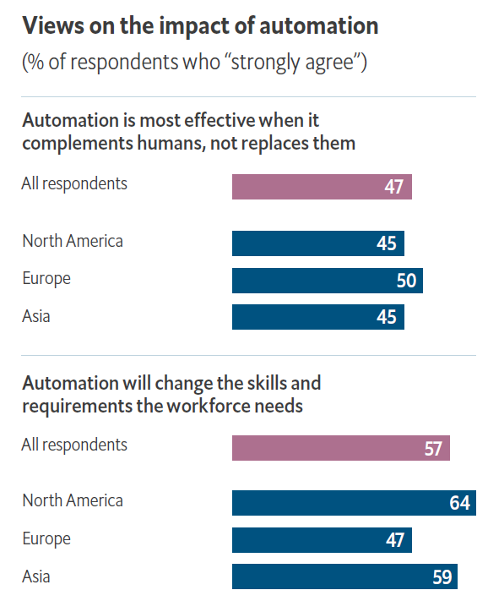
1.4 Summary
Automation Benefits:
(Automatically) produce the required for human survival & development by (automatically) sourcing resources from this planet.
A potential benefit attractive to many managers is the freeing up of employees to focus on higher-level activities.
Automation Hurdles:
Technology-specific issues also figure prominently, but nearly as important are human factors: an absence of relevant skills and employee resistance.
Source: https://automationfirst.economist.com/wp-content/uploads/2019/06/EIU-UiPath-The-advance-of-automation-briefing-paper.pdf

Slide 36
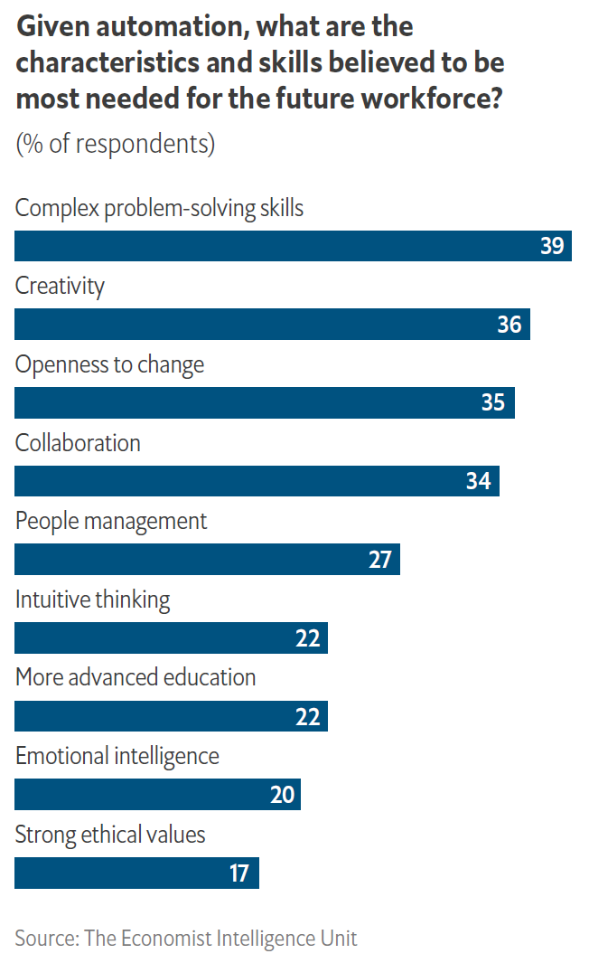
1.4 Summary
Moving Forward:
All C-suite respondents emphasize the importance of providing education and reskilling opportunities as a means of lessening resistance.
The types of skills that respondents believe will be most in need revolve around problem solving, creativity and collaboration.
Source: https://automationfirst.economist.com/wp-content/uploads/2019/06/EIU-UiPath-The-advance-of-automation-briefing-paper.pdf

Slide 37
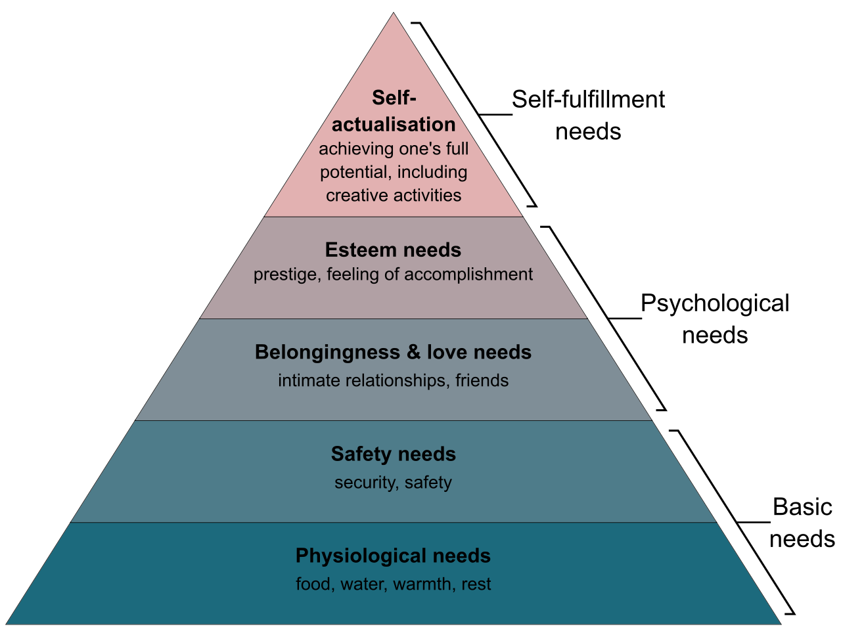
Maslow’s Hierarchy of Human Needs

Slide 38

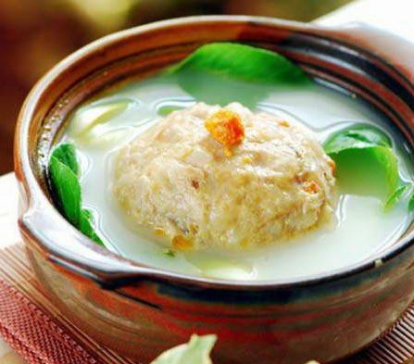
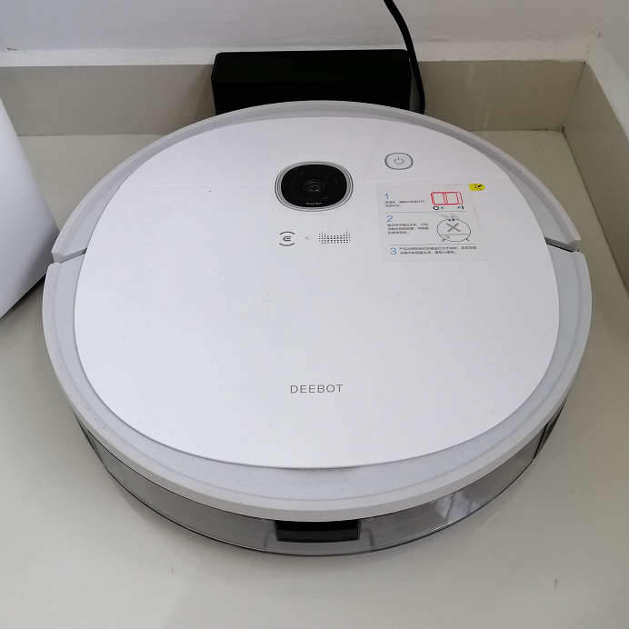
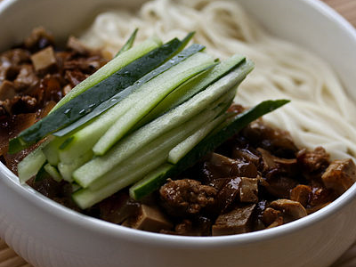
1.4 Summary
Sam’s success story of home automation journey:
Return on Investment (ROI): S$600 (TCO) in 1 week only! (our private home tuition S$100/hour)

Slide 39

Master Degree in Artificial Intelligence / Intelligent Systems
Graduate Certificate in Intelligent Reasoning
Systems
Graduate Certificate in Pattern Recognition
Systems
Graduate Certificate in Pattern Recognition Systems
Graduate Certificate in Intelligent Sensing Systems
Graduate Certificate in Intelligent Software Agents
Graduate Certificate in Practical Language
Processing
Graduate Certificate in Intelligent Robotic Systems
Machine Reasoning (SF)
4 days
Problem Solving using Pattern Recognition (SF)
5 days
Vision
Systems (SF)
5 days
Intelligent
Process Automation
3 days
Text Analytics (SF)
3 days
Robotic
Systems (SF)
5 days
NUS MTech Pathway:
1-year full time
2-year part time
7-year flexible stackable
Cognitive
Systems
3 days
Spatial Reasoning from Sensor Data (SF)
3 days
Software
Robots
4 days
New Media and Sentiment Mining (SF)
4 days
Autonomous Robots & Vehicles
5 days
Intelligent Sensing and Sense Making (SF)
4 days
Reasoning
Systems (SF)
5 days
Speech and Sound Sensing Systems
4 days
Self-Learning Systems
4 days
Human-Robot System Engineering
4 days
Text Processing Using Machine Learning (SF)
5 days
Pattern Recognition and Machine Learning Systems (SF)
5 days
Practice Module
10 man days
Practice Module
10 man days
Practice Module
10 man days
Practice Module
10 man days
Practice Module
10 man days
Conversational Interfaces
5 days
Practice Module
10 man days

Slide 40
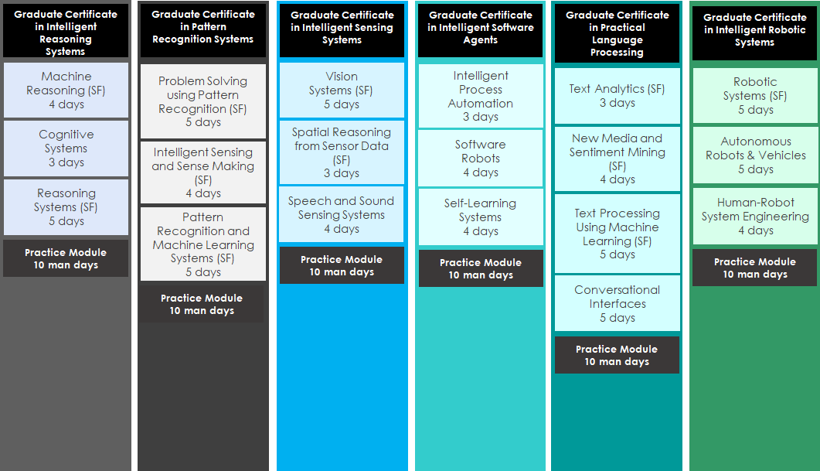
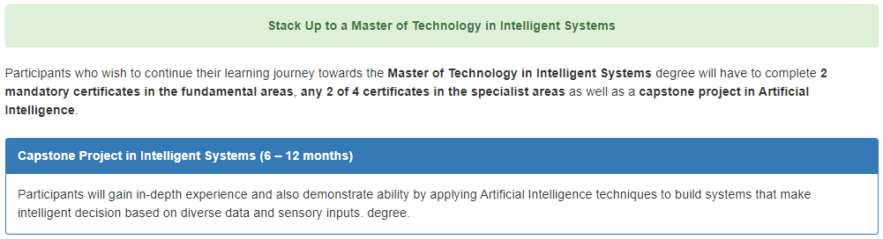

4 Certificates Courses (Pillars)
Capstone Project
NUS Master Degree

Slide 41
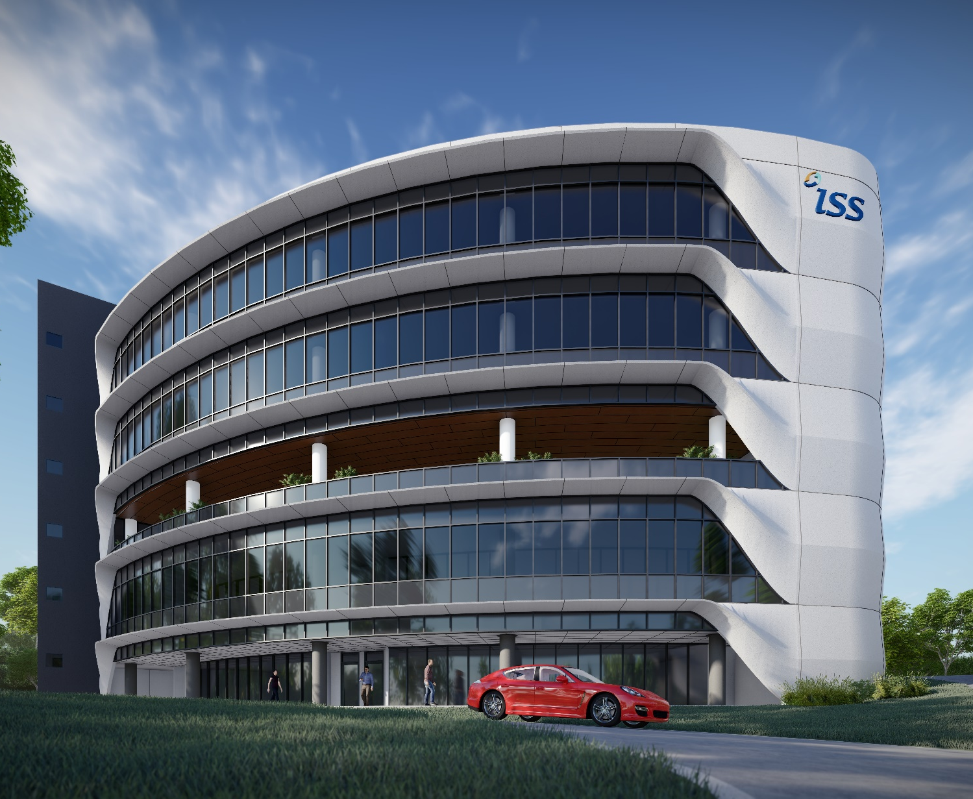






www
www.iss.nus.edu.sg
www.facebook.com/ISS.NUS
twitter.com/ISSNUS
@iss.nus
www.linkedin.com/company/iss_nus
youtube.com/user/TheISSNUS/

Slide 42

Source: https://www.proedgeskills.com/wp-content/uploads/2018/01/ps-questions-answers-800-500.jpg

Slide 43
The End

